Slide 1
Scientific writing
Week one

Slide 2

Overall picture

Slide 3
What is research?
What is the structure of a research paper?
What is the main features of a research paper?

Slide 4

1. What is research?
This is a question for my dear students~

Slide 5
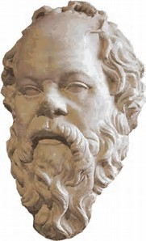

Slide 6
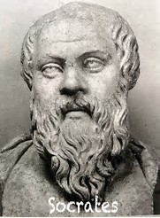

Slide 7
Everyone engages in some form of research almost every day, though usually without thinking of it as research. If you have a free evening and want to go to a movie, you may pick up a newspaper or go online and look through the movie reviews to help you decide what you want to see. Or you may ask your friends for their recommendations. If you’re in the market for a new car, you may search the Internet for the one that best fits your needs and your budget, and you may look for the best deal on that model in the same way. Anyone who wants to decide what college to attend, predict which team will win the Super Bowl, invest in stock, buy a house, plan a vacation, or find the best price on a cell phone app will need to conduct some form of research to achieve those goals (Coyle & Law 2015: 1).

Slide 8

Pinpoint a research topic
1. focus on your instructor’s input
2. follow your personal interests
3. talk with other people
4. brainstorm
5. read source materials

Slide 9
2. What is the structure of a research paper?
What is the structure of an argumentative writing?

Slide 10
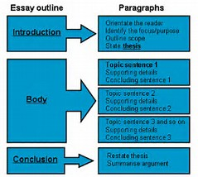

Slide 11





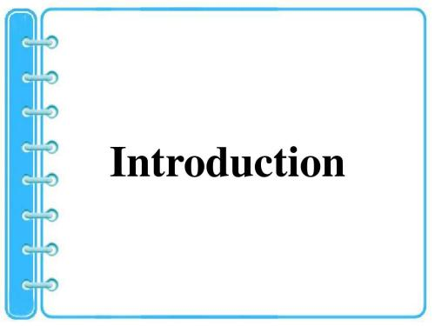



Slide 12
Abstract
Introduction
Materials and methods
Results
Discussion
Conclusion
Acknowledgement
References

Slide 13
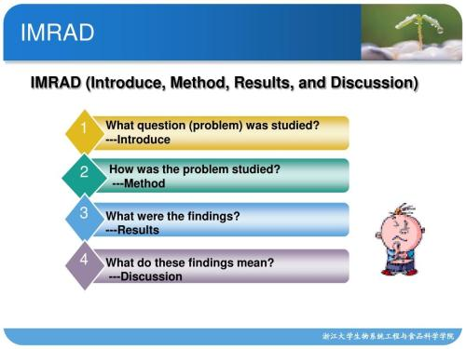

Slide 14
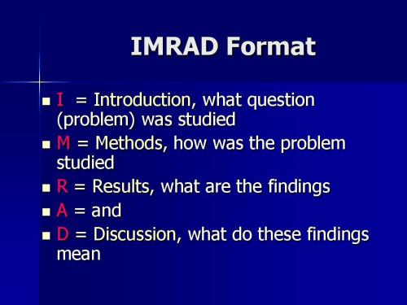

Slide 15
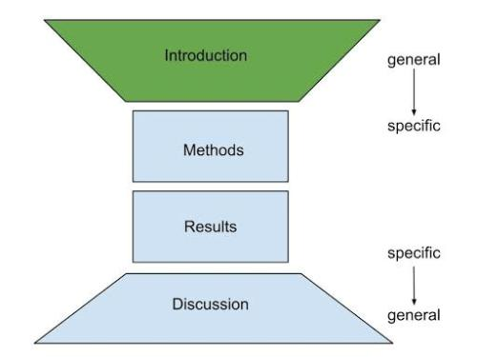

Slide 16
The main purpose of the Introduction is to provide the rationale for the paper, moving from general discussion of the topic to the particular question or hypothesis being investigated. A secondary purpose is to attract interest in the topic―and hence readers.

Slide 17
The Methods section describes, in various degrees of detail, methodology, materials (or subjects), and procedures. This is the narrowest part of the academic paper.

Slide 18
In the Results section, the findings are described, accompanied by variable amounts of commentary.

Slide 19
The Discussion section offers an increasingly generalized account of what has been learned in the study. This is usually done through a series of “points”, at least some of which refer back to statements made in the Introduction.

Slide 20

Let us have a look at several papers here.

Slide 21
Which part might you read first?

Slide 22
Which part might you write first?
在实际的写作中，撰写各章节的先后顺序可能依次为（任胜利 2011：41）：
Methods-Results-Discussion-Introduction-Title-Abstract

Slide 23
Identify which part of a research paper might the following phrases come from?
It is very likely that … because… ( )
…yielded a total of… ( )
The aim of the work described… ( )
… was used to calculate… ( )
There have been few long-term studies of … ( )
The vertical distribution of … was determined by … ( )
This may be explained by… ( )
Analysis was carried out using… ( )
…was highly correlated with… ( )

Slide 24
Identify which part of a research paper might the following phrases come from?
It is very likely that … because… (D)
…yielded a total of… (R)
The aim of the work described… (I)
… was used to calculate… (M) or (R)
There have been few long-term studies of … (I)
The vertical distribution of … was determined by … (M) or (R)
This may be explained by… (D)
Analysis was carried out using… (M)
…was highly correlated with… (R)

Slide 25
3. What is the main features of a research paper?
The fundamental purpose of academic discourse is not the mere presentation of information and thought, but rather its actual communication. It does not matter how pleased an author might be to have converted all the right data into sentences and paragraphs; it matters only whether a large majority of the reading audience accurately perceives what the author had in mind (史文霞 2012: 3).

Slide 26
The primary goals of professional communication are accuracy, clarity, and completeness (蔡基刚 2016：25).

Slide 27


Slide 28


Slide 29
Let us look at two texts here.

Slide 30
Let us look at two more texts.

Slide 31
Text 2
Because only a few people have most of the money and power in Australia. I conclude that it is not an equal society. Society has an Upper, Middle and Lower class and I think that most people when they are born into one class, end up staying in that class for their whole lives. When all three classes are looked at more closely, other things such as the differences between the sexes and people’s racial backgrounds also add to the unequal nature of Australian society.

Slide 32
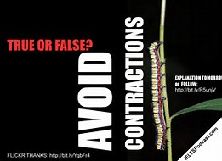

A further comment on “not”
Trade won’t improve until the economy is stronger.
Trade will not improve until the economy is stronger.

Slide 33
There isn’t any consistency in the results of the two experiments.
There is no consistency in the results of the two experiments.
Use no, little, few
Avoid not…any, not…much, not many

Slide 34
Not many people achieved the greatness of George Washington.
Few people achieved the greatness of George Washington.

Slide 35
A further comment on “many”
Scientific writing should be accurate, appropriate and measured. To achieve greater accuracy, eliminate words such as “a lot”, “a bit” and “a little” in scientific writing. There have no value. Alternatives for “a lot” include:
several, many, certain, numerous, considerable
(Skern 2014: 15)

Slide 36

A lot
Make your scientific writing appropriate by avoiding adjectives such as “amazing”, “incredible”, “unbelievable”, “stunning” or “spectacular” (Skern 2014: 16).

Slide 37
Two exercises on writing concisely.

Slide 38
made a decision | decided
reached an agreement | agreed
expressed a denial | denied
made a request | requested
ventured an attempt | tried
granted permission | permitted or allowed

Slide 39
At this point in time | Now
due to the fact that | because
during the time that | while
for the reason that | because
in a short time | soon
in spite of the fact that | although
in the place that | where
prior to the time that | before
last but not least | Last
in the recent time | recently

Slide 40



Slide 41
One more example
While the reactions of the anion were solvent-dependent, the corresponding reactions of the substituted derivatives were not.
Although the reactions of the anion were solvent-dependent, the corresponding reactions of the substituted derivatives were not.

Slide 42
Final assessment
70% homework
20% final writing
10% attendance

Slide 43
Homework this week
Find 3 research papers in English, and read the “introduction” part, and then send the papers to me: gaoyuan@ucas.ac.cn
Please take the papers with you next week!

Slide 44


